Slide 1

Module-4
Searching Algorithms

Slide 2
Searching
Definition:This is the process by which one searches the group of elements for the desired element
Based on the type of search operation, these algorithms are generally classified into two categories:
Sequential /Linear Search: In this, the list or array is traversed sequentially and every element is checked. For example: Linear Search.
Binary Search: These algorithms are specifically designed for searching in sorted data-structures. These type of searching algorithms are much more efficient than Linear Search as they repeatedly target the center of the search structure and divide the search space in half.

Slide 3
Linear Search
In this technique of searching, the element to be found in searching the elements to be found is searched sequentially in the list. This method can be performed on a sorted or an unsorted list (usually arrays).
In case of a sorted list searching starts from 0th element and continues until the element is found from the list or the element whose value is greater than (assuming the list is sorted in ascending order), the value being searched is reached.

Slide 4
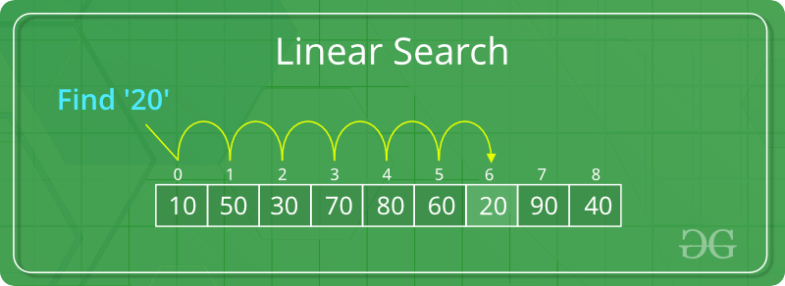
Linear search Example
Linear Search to find the element “20” in a given list of numbers

Slide 5
Algorithm for Linear Search
algorithm Seqnl_Search(list, item)
Pre: list != ;
Post: return the index of the item if found, otherwise: 1
index <- fi
while index < list.Cnt and list[index] != item //cnt: counter variable
index <- index + 1
end while
if index < list.Cnt and list[index] = item
return index
end if
return: 1
end Seqnl_Search

Slide 6
Binary Search
Binary search is a very fast and efficient searching technique. It requires the list to be in sorted order. In this method, to search an element you can compare it with the present element at the center of the list.
If it matches, then the search is successful otherwise the list is divided into two halves: one from the 0th element to the middle element which is the center element (first half) another from the center element to the last element (which is the 2nd half) where all values are greater than the center element.
The searching mechanism proceeds from either of the two halves depending upon whether the target element is greater or smaller than the central element. If the element is smaller than the central element, then searching is done in the first half, otherwise searching is done in the second half.

Slide 7
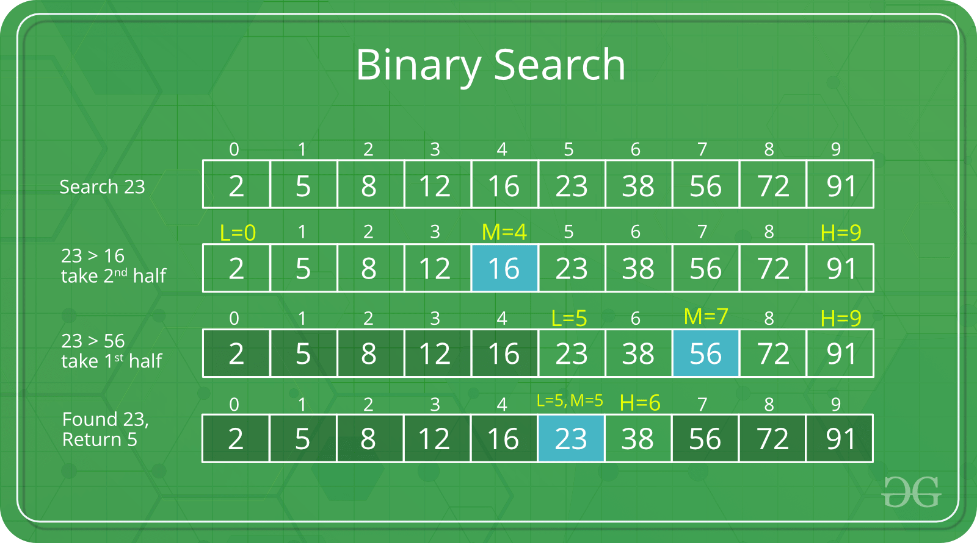
Binary Search Example
Binary Search to find the element “23” in a given list of numbers

Slide 8
Algorithm for Binary Search
algorithm Binary_Search(list, item)
Set L to 0 and R to n: 1
if L > R, then Binary_Search terminates as unsuccessful
else
Set m (the position in the mid element) to the floor of (L + R) / 2
if Am < T, set L to m + 1 and go to step 3
if Am > T, set R to m: 1 and go to step 3
Now, Am = T,
the search is done; return (m)

Slide 9
Acknowledgment
Lessonstoall.com
w3resource.com
w3school.com
greeksforgreeks.com

Slide 10
Thank You

